Slide 1
IR Communication Launchpad Edition(EX)
Members: Bradford Manning, Sunho Kim, Jonathon Moore

Slide 2
Why is IR communication important?
Faster data transfer than WIFI and Bluetooth, some models can go up to 1Gbps
Cheaper, and easier method of wireless communication
Adaptable and easier to use, with ability to give higher bandwidths than just Wifi.

Slide 3
What did we do?
We made 2 IR communicators using 2 TI Launchpads and a GUI created using Visual Studio
The 2 IR devices can communicate with each other quickly by transferring IR signals of bytes. We can then convert the bytes into ASCII values to create and send actual messages to the other device and vice-versa.

Slide 4
Impacts of IR in the future
WIFI and Bluetooth have grown increasingly popular over the years while IR communication was somewhat side-lined. However IR communication holds great promise and has a possibility to better our technology by providing us faster, cheaper wireless communication, developed further it could even provide us this service with the same range as WIFI and Bluetooth with smaller limitations such as loss of bandwidth and cost-efficiency.

Slide 5


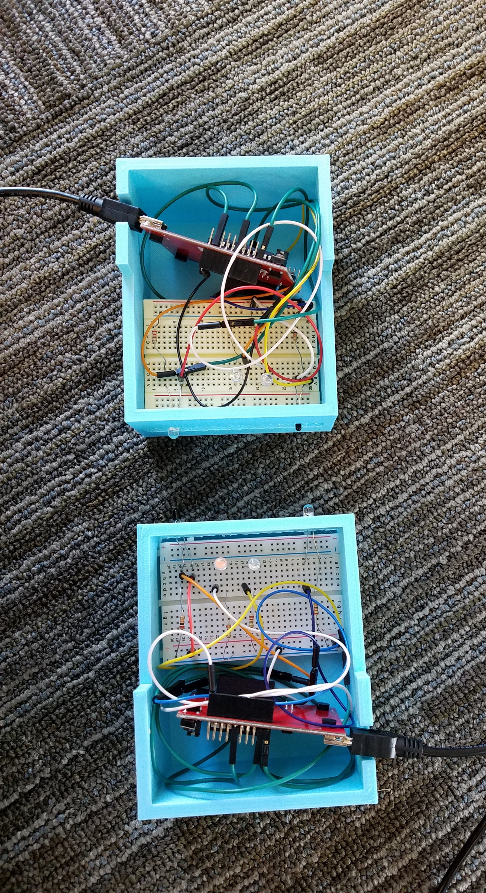
IR Communication Devices
Interaction between the devices and the GUI

Slide 6



